Slide 1

基于AngularJS的移动销售WebAPP
主讲人：高利 201400301186
2014级4班

Slide 2

目录
项目简介
1
项目难点
2
项目进度
3

Slide 3
产品简介
1
项目简介
project brief
项目背景
项目意义

Slide 4
使用场景
该应用的适用场景为零售商与经销商之间的进行商品交易，是一个应用于B2B场景而非B2C场景
产品简介

Slide 5
使用人群
零售商有固定的商品来源，由批发商的销售代表定期回访零售商，销售代表通过该应用实现商品销售以及数据统计
产品简介

Slide 6
产品功能
1. 统计零售商库存
2. 管理零售商信息
3. 商品销售、订单结算
4. 促销优惠
产品简介

Slide 7
随着移动终端的不断普及，以及移动终端资费的下调，越来越多的互联网入口开始向移动端倾斜
项目背景
HTML5的不断发展和完善，将Web应用在移动端的适配变得日益完善，移动端与PC端有相似的用户体验
传统的批发零售行业中批发商缺少主动性，并且商品采购销售等缺少规范的流程

Slide 8
项目意义
HTML5 移动终端
平台无关
使用HTML5进行APP开发能够实现平台无关性，在Android、IOS以及Windows平台都可以运行
一套代码能够适配多种平台，减轻了开发人员的维护难度
批发零售
流程规范
该系统能够将采购销售的流程电子化，提高执行的透明度
能够进行多种组合方式的促销优惠，并且能够简化销售人员工作强度

Slide 9
页面设计
2
前后端分离
项目难点
Project difficulties
跨域访问
促销逻辑

Slide 10
难点解决
页面设计
前后端分离
跨域访问
促销逻辑
学习使用Axure RP进行项目原型图设计，并绘制流程图以及进行其他项目架构设计
前端开发工具：HBuilder
后端开发工具：IDEA
数据交流：JSON
无法解决：校园网IP不允许校外访问
前端框架：AngularJS
后台框架：Spring Boot
使用@crossorigin标签以及在URL中添加http实现跨域
使用策略模式和简单工厂模式的结合，将各种促销逻辑进行封装，降低耦合度
项目中问题解决：https://blog.csdn.net/qq_27058023/ （持续更新中）

Slide 11
需求分析
3
概要设计
项目进度
project progress
详细设计
编码实现

Slide 12
项目进度
进行项目概要设计并编写HLD
进行数据库设计并绘制ER图
选择毕设题目
学习AngularJS Spring Boot知识
完善项目代码，逐步实现项目功能。
完善毕业论文
1
2
3
4
5
进行项目需求分析
搭建项目环境
在github中建立相关工程
绘制项目原型图
着手部分代码开发
进行毕业论文资料的准备

Slide 13
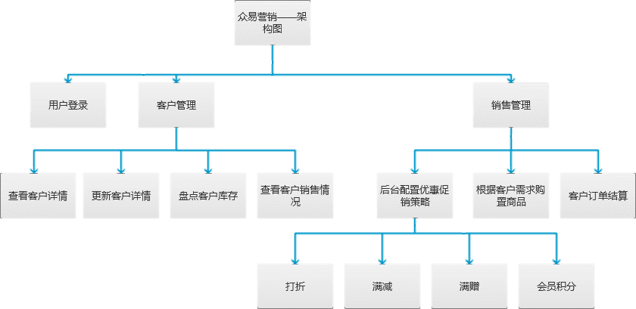

Slide 14
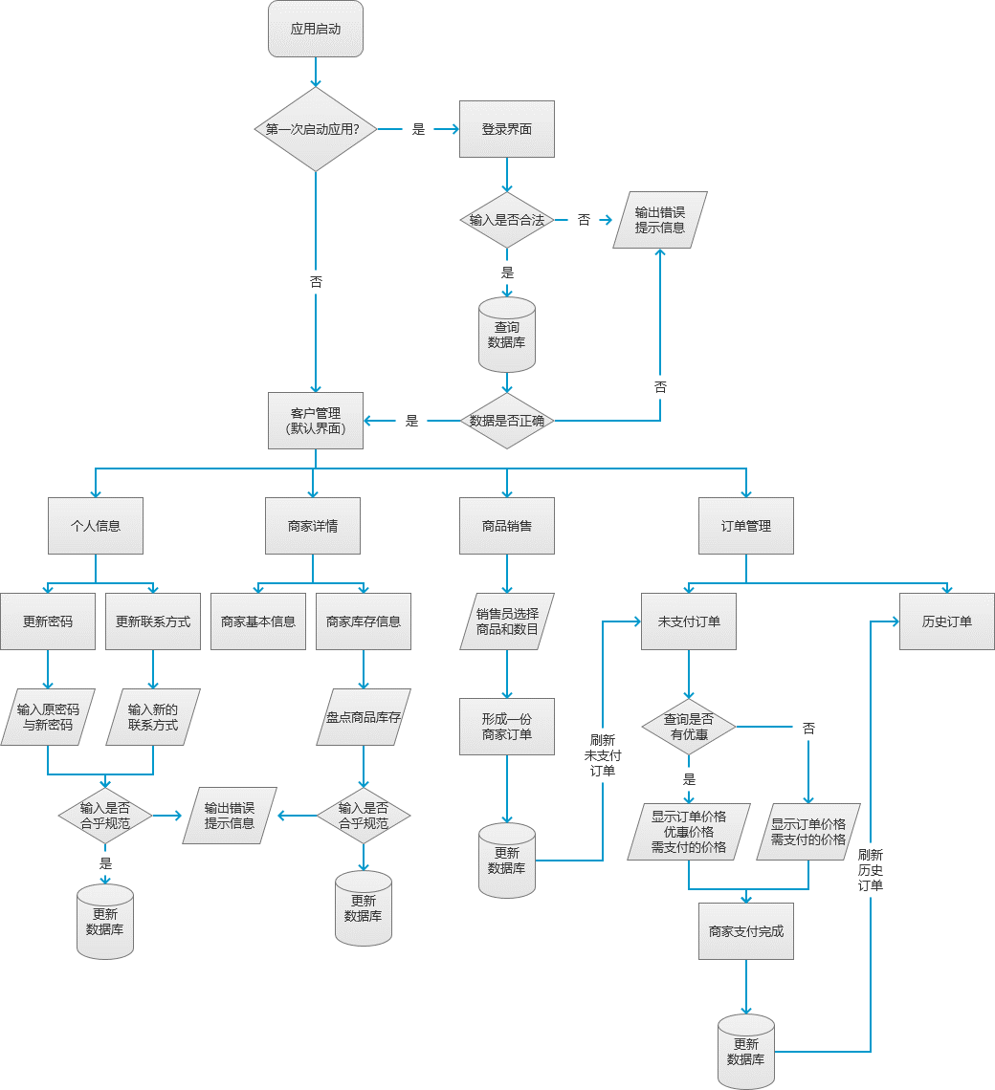

Slide 15
项目进度
代码及文档地址
前端工程地址：https://github.com/gaoli9512/MobileSaleApp
后台工程地址：https://github.com/gaoli9512/MobileSale
毕业设计相关文档地址：
https://github.com/gaoli9512/Graduation-design-document

Slide 16
谢谢观看
PPT模板下载：www.1ppt.com/moban/ 行业PPT模板：www.1ppt.com/hangye/
节日PPT模板：www.1ppt.com/jieri/ PPT素材下载：www.1ppt.com/sucai/
PPT背景图片：www.1ppt.com/beijing/ PPT图表下载：www.1ppt.com/tubiao/
优秀PPT下载：www.1ppt.com/xiazai/ PPT教程： www.1ppt.com/powerpoint/
Word教程： www.1ppt.com/word/ Excel教程：www.1ppt.com/excel/
资料下载：www.1ppt.com/ziliao/ PPT课件下载：www.1ppt.com/kejian/
范文下载：www.1ppt.com/fanwen/ 试卷下载：www.1ppt.com/shiti/
教案下载：www.1ppt.com/jiaoan/
字体下载：www.1ppt.com/ziti/

Slide 17
点击输入小标题
My flower is ephemeral, and she has only four thorns to defend herself against the
My flower is ephemeral, and she has only four thorns to defend herself against the
XX定理
My flower is ephemeral, and she has only four thorns to defend herself against the
My flower is ephemeral, and she has only four thorns to defend herself against the
My flower is ephemeral, and she has only four thorns to defend herself against the
My flower is ephemeral, and she has only four thorns to defend herself against the

Slide 18
点击输入小标题
小标题
小标题
His flower had told him that she was only one of her kind in all universe. And here were five thousand of them, all alike, in one single garden!
His flower had told him that she was only one of her kind in all universe. And here were five thousand of them, all alike, in one single garden!
重要
定理
小标题
小标题
His flower had told him that she was only one of her kind in all universe. And here were five thousand of them, all alike, in one single garden!
His flower had told him that she was only one of her kind in all universe. And here were five thousand of them, all alike, in one single garden!
小标题
小标题
His flower had told him that she was only one of her kind in all universe. And here were five thousand of them, all alike, in one single garden!
His flower had told him that she was only one of her kind in all universe. And here were five thousand of them, all alike, in one single garden!

Slide 19
点击输入小标题
需求分析
My flower is ephemeral, and she has only four thorns to defend herself against the world. And I have left on my planet, all alone! His flower had told him that she was only one of her kind in all universe.
小标题
My flower is ephemeral, and she has only four thorns to defend herself against the world. And I have left on my planet, all alone! His flower had told him that she was only one of her kind in all universe.
小标题
My flower is ephemeral, and she has only four thorns to defend herself against the world. And I have left on my planet, all alone! His flower had told him that she was only one of her kind in all universe.

Slide 20
点击输入小标题
My flower is ephemeral, and she has only four thorns to defend herself against the world.
My flower is ephemeral, and she has only four thorns to defend herself against the world.
My flower is ephemeral, and she has only four thorns to defend herself against the world.
My flower is ephemeral, and she has only four thorns to defend herself against the world.
拓展
My flower is ephemeral, and she has only four thorns to defend herself against the world.
My flower is ephemeral, and she has only four thorns to defend herself against the world.

Slide 21
点击输入小标题
小标题
And I have left on my planet, all alone! His flower had told him that she was only one of her kind in all universe.
标题
小标题
And I have left on my planet, all alone! His flower had told him that she was only one of her kind in all universe.
小标题
And I have left on my planet, all alone! His flower had told him that she was only one of her kind in all universe.

Slide 22
点击输入小标题
My flower is ephemeral, and she has only four thorns to defend herself against the world.
My flower is ephemeral, and she has only four thorns to defend herself against the world.
My flower is ephemeral, and she has only four thorns to defend herself against the world.
My flower is ephemeral, and she has only four thorns to defend herself against the world.
My flower is ephemeral, and she has only four thorns to defend herself against the world.
My flower is ephemeral, and she has only four thorns to defend herself against the world.

Slide 23
经典应用
4
旧题新解
随堂测试
In-class test
随堂小练
答案解析

Slide 24
点击输入小标题
小标题
My flower is ephemeral, and she has only four thorns to defend herself against the world. And I have left on my planet, all alone! His flower had told him that she was only one of her kind in all universe. And here were five thousand of them, all alike, in one single garden! I thought that I was rich, with a flower that was unique in all the world; and all I had was a common rose. A common rose…
小标题
小标题
小标题
小标题
And I have left on my planet, all alone! His flower had told him that she was only one of her kind in all universe.
And I have left on my planet, all alone! His flower had told him that she was only one of her kind in all universe.
And I have left on my planet, all alone! His flower had told him that she was only one of her kind in all universe.
And I have left on my planet, all alone! His flower had told him that she was only one of her kind in all universe.

Slide 25

点击输入小标题
解1
解2
My flower is ephemeral, and she has only four thorns to defend herself against the world. And I have left on my planet, all alone! His flower had told him that she was only one of her kind in all universe. And here were five thousand of them, all alike, in one single garden! I thought that I was rich, with a flower that was unique in all the world; and all I had was a common rose. A common rose…
My flower is ephemeral, and she has only four thorns to defend herself against the world. And I have left on my planet, all alone! His flower had told him that she was only one of her kind in all universe. And here were five thousand of them, all alike, in one single garden! I thought that I was rich, with a flower that was unique in all the world; and all I had was a common rose. A common rose…

Slide 26
点击输入小标题
此处输入标题
小标题
My flower is ephemeral, and she has only four thorns to defend herself against the world. And I have left on my planet, all alone! His flower had told him that she was only one of her kind in all universe. And here were five thousand of them, all alike, in one single garden! I thought that I was rich, with a flower that was unique in all the world; and all I had was a common rose. A common rose…
此处输入标题
此处输入标题

